Slide 1
Block to fake sneakers

Slide 2
abstract
Do you know that footwear is the most commonly counterfeited item? Have you ever wonder how the fake manufacturer earn by selling sneaker at a much cheaper cost? Well, these manufacturer earns huge profits as they bypass manufacturing costs like original design and research, marketing, and regulation. Even sneaker experts found it difficult to distinguish fakes from real ones.With our solution, you can pull out your smartphone and scans the microchip in the sneakers. And, you will know if the sneaker is real or fake.

Slide 3
introduction
Today, shoes are the most counterfeited item in the world. Brands globally are being impacted by the practice, with brands most-affected by counterfeiting last year including international labels such as Nike, Adidas, UGG and Christian Louboutin.
With the luxury footwear industry supported by brand appeal and design as opposed to function, the damage that counterfeits can cause is immense.

Slide 4
The shoe industry has experienced a massive growth in recent years, where the global economy has improved to the point that even the casual consumer can afford to keep up with rapidly changing fashion trends.
Basketball shoes are currently experiencing the fastest-growing market share, driven by product hype stirred on social media channels and by market influencers such as athletes.

Slide 5
Problem statement
Unfortunately for footwear brands, outsourced manufacturing has meant that counterfeiting has become difficult to control.
A 2011 WikiLeaks exposure shows how Nike have struggled with counterfeiting, detailing corrupt law enforcement practices and an acknowledgement of ‘third-shift’ manufacturing, where factories illegally produce goods from designs they have been contracted for, creating near-identical products.

Slide 6
Amazon isn't responsible for third-party counterfeits, as its Fulfilled by Amazon service acts as a shield against liability. That's the main reason the high-fashion industry refuses to work with Amazon.

Slide 7
Existing solution
Reporting on the footwear counterfeit industry, the New York Times interviewed a counterfeit producer who claimed that “the only way you can tell the difference between the real ones and ours is by the smell of the glue”.
Sites like eBay also have programs in place to combat counterfeits, such as VeRo (Verified Rights Owner), which allows intellectual property owners and their authorized sellers to report eBay listings that may be fake.

Slide 8
Big Data Anti-Counterfeiting Alliance, Alibaba is using artificial intelligence to crack down on fakes.

Slide 9
Project design
While manufacturing ,we have fix a smart tag (NFC)in every sneakers.
Read the unique id from tag and send it to the cloud to perform blockchain concept through the Raspberry Pi.
Using java platform,generate a hash to make chain of blocks.
Store all the details of products with NFC id and also with itd hash value in database.
At the buying side,consumers need to have a app build by sneaker’s company that will take a chip id and check it with database.

Slide 10
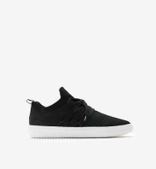
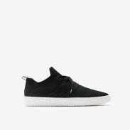
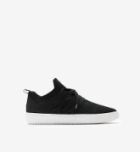
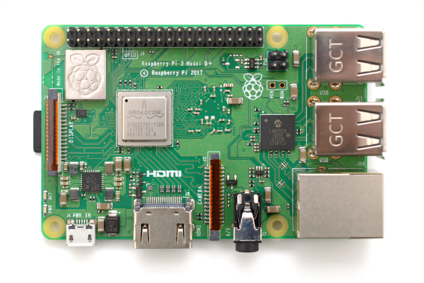
Block diagram
NFC Reader
NFC CHIP
NFC CHIP
NFC CHIP
Cloud
Java platform (Blockchain)
Unique ID | Hash value | Product model | Size
23426522 | fwyt5276geye538uge77y76 | 78555 | 8
23426534 | 756gyut7645rtf576t7yf647 | 78455 | 9

Slide 11
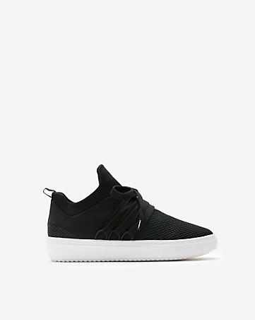
NFC Reader
NFC CHIP
(APP)
Unique ID | Hash value | Product model | Size
23426522 | fwyt5276geye538uge77y76 | 78555 | 8
23426534 | 756gyut7645rtf576t7yf647 | 78455 | 9

Slide 12
system requirements
HAREDWARE :
Raspberry Pi
NFC reader device.
NFC chip.
SOFTWARE:
Python software
Java platform
MySql

Slide 13
CONCULSION
Thus,we making a project to put an end to the fake sneakers coming into the world by a just a java platform.

Slide 14
THANK YOU

